Slide 1
Regression Algorithms
Simple Linear Regression, Multivariate Linear Regression
Prof. H.P.Channe

Slide 2
Simple Linear Regression
In this problem we have an input variable X and one output variable Y.
And we want to build linear relationship between these variables.
The input variable is called Independent Variable
The output variable is called Dependent Variable.
We can define this linear relationship as follows:
Y=β₀ + β₁ X
The β₁ is called a scale factor or coefficient and β₀ is called bias coefficient.
This equation is similar to the line equation y = mx+b with m=β1 (Slope) and b = β0 (Intercept).
So in this Simple Linear Regression model we want to draw a line between X and Y which estimates the relationship between X and Y.

Slide 3
Coefficients of Linear Regression
Coefficints can be determined using the two approaches:
1.Ordinary Least Square Method (OLSM)
2. Gradient Descent Approach.

Slide 4
Ordinary Least Square Method
Compute β₀ and β₁
and
$β_{1}=\frac{\sum_{i}{\left(x_{i}−\bar{x}\right)}\left(y_{i}−\bar{y}\right)}{\sum_{i}{{\left(x_{i}−\bar{x}\right)}^{2}}}$
$β_{0}=\bar{y}−β_{1}∗\bar{x}$
In these equations xˉ is the mean value of input variable X and yˉ is the mean value of output variable Y.

Slide 5
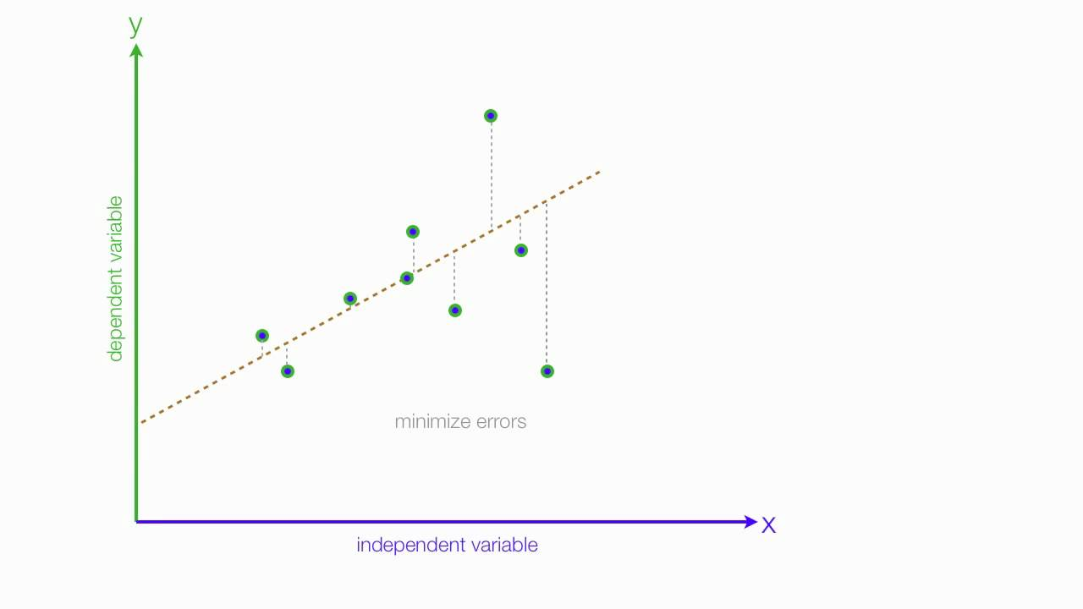
Error
We plot scatter points in 2D space.
The error of each point is the distance between the regression line and that point.
Figure- Green dots: Actual data points.
Brown line: Regression Line

Slide 6

Accuracy of the model
Root Mean Squared Error is the square root of the sum of all errors divided by the number of values, or Mathematically:
Where: y_{j} is actual value of y and
${\hat{y}}_{j}$
is predicted value of y.

Slide 7
R² score
R-Squared: Also known as the Coefficient of Determination
It has a value between 0 and 1 that measures how well our regression line fits our data.
R-Squared can be interpreted as the percent of variance in our dependent variable that can be explained by our model.
The closer R-Squared is to 1 or 100% the better our model will be at predicting our dependent variable.

Slide 8
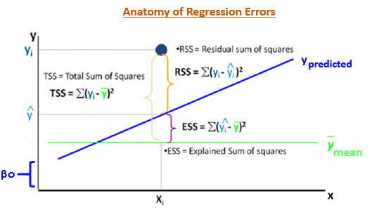
Figure source cs.brown.edu

Slide 9
R² score
R² score is used to measure the accuracy of our linear model, mathematically :
SSTotal is the total sum of squares and SSResiduals is the total sum of squares of residuals.
R² Score usually ranges from 0 to 1.
It will also become negative if the model is completely wrong.
The R-Squared formula compares our fitted regression line to a baseline model.
This baseline model is considered the “worst” model.
The baseline model is a flat-line that predicts every value of y will be the mean value of y.
R-Squared checks to see if our fitted regression line will predict y better than the mean will.
$R^{2}=1−\frac{{SS}_{Regression}}{{SS}_{Total}}$
$R^{2}=1−\frac{{SS}_{Residuals}}{{SS}_{Total}}$
$R^{2}=1−\frac{{SS}_{Residuals}}{{SS}_{Total}}=\frac{\sum_{i=0}^{N}{{\left(y_{i}−\hat{y}\right)}^{2}}}{\sum_{i=0}^{N}{{\left(y_{i}−\bar{y}\right)}^{2}}}$

Slide 10
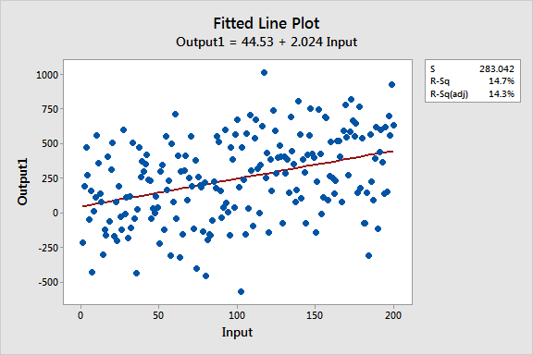
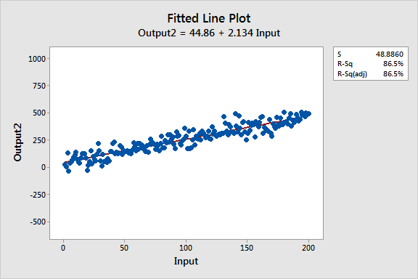
Differences Between the Regression Models
The variability of the data around the two regression lines.
R2 and S (standard error of the regression) numerically describe this variability.
The low R-squared graph shows that even noisy, high-variability data can have a significant trend.
The trend indicates that the predictor variable still provides information about the response even though data points fall further from the regression line.

Slide 11
Dataset Description
We are going to use a dataset of advertising containing two columns: TV advertising and Sales.
Establish relationship between TV advertisement and Sales.
Here X = TV advertising
Y = Sales

Slide 12
Simple Linear Regression Steps
Step 1: Load the data using pandas library
Step 2: Calculate β₀ and β₁
Step 3: Calculate Ypredicted = β₀ + β₁*x
Step 4: Calculate the accuracy of the model using RMSE and coefficient of Determination (R² Score)
Step 5: Plot original values of y vs x and estimated values of Ypredicted vs x
Now we will implement this model in Python.

Slide 13
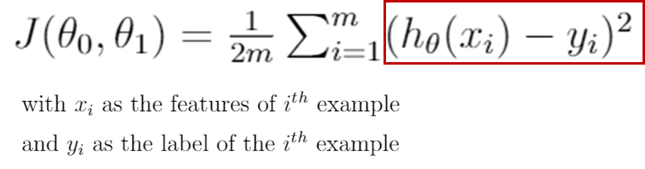
Cost Function
It is a function that measures the performance of a model for given data.
Cost Function quantifies the error between predicted values and expected values and presents it in the form of a single real number.
h_{θ}(x_{i}) = θ₀ + θ₁*x_{i}

Slide 14
Gradient Descent (GD)
One of the methods we can use to minimize cost is Gradient Descent, which is based on using gradients (derivatives) to update the model parameters (theta in our case) until a minimum is found and the gradient becomes zero.
Learning rate gives the rate of speed where the gradient moves during gradient descent.
Setting it too high would make your path instable, too low would make convergence slow.
Put it to zero means your model isn't learning anything from the gradients.

Slide 15
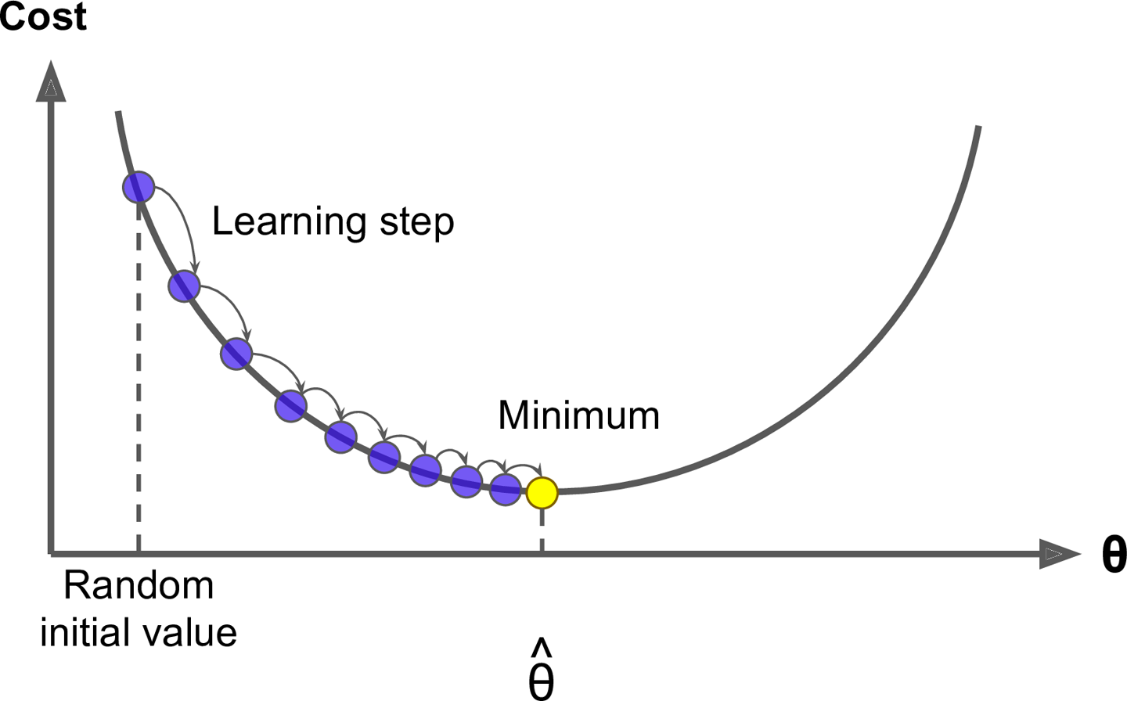
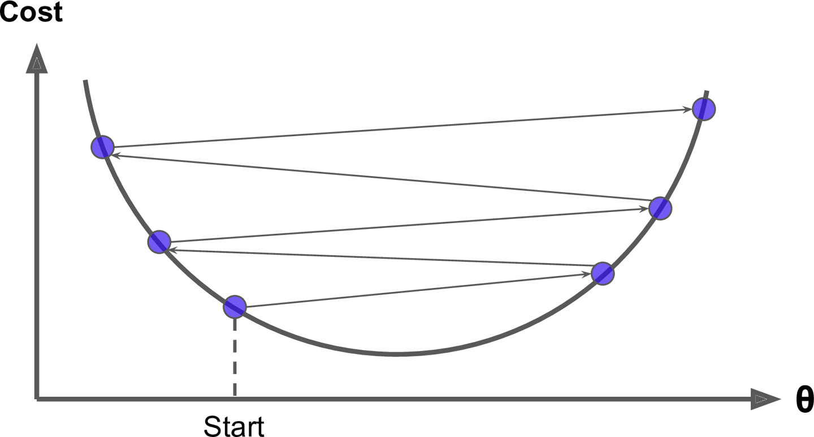
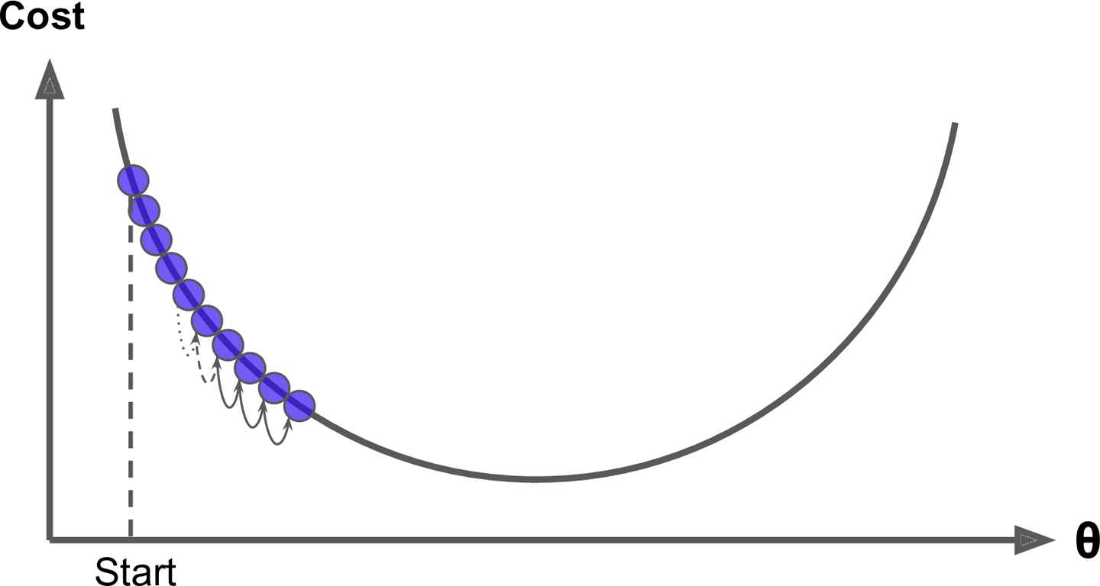
Learning rate is too high
Learning rate is too low
Figure source: Hands on Machine Learning with Scikit-learn and Tensorflow

Slide 16
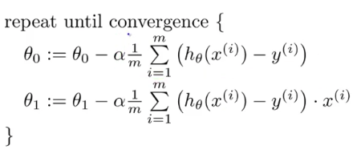
Computing the Coefficients

Slide 17
Dataset Description
We are going to use a dataset with two columns consisting of head size and brain weight to predict brain weight.
1. Head Size in cm^3
2. Brain Weight in gm

Slide 18
Simple Linear Regression using GD Steps
Step 1: Load dataset into dataframe using Pandas
Step 2: Load dataset into numpy arrays x and y
Step 3: Using gradient descent calculate the parameters θ₀ to θ₁.
Step 4: Plot Cost (Error) vs Iteration
Step 5: Plot the original datapoints (x vs y) and (ypredicted vs x).

Slide 19
Multivariable Linear Regression
Multivariable linear regression (MLR) is used to determine a mathematical relationship among a number of random variables.
In other terms, MLR examines how multiple independent variables (X_{i}) are related to one dependent variable (Y).

Slide 20
Multiple Linear Regression
The equation of multiple linear regression is listed below:
Here 'y' is the dependent variable to be estimated, and X are the independent variables and ε is the error term. βi’s are the regression coefficients.
Y =
$f\left(x_{1}{\text{,x}}_{2}{\text{,x}}_{3},\text{.}\text{.}\text{.}{\text{,x}}_{n}\right){\text{=θ}}_{0}{\text{+θ}}_{1}x_{1}{\text{+θ}}_{2}x_{2}{\text{+θ}}_{3}x_{3}+\text{.}\text{.}\text{.}{\text{+θ}}_{n}x_{n}$

Slide 21
Model Representation
In this problem we have ‘n’ input variables X_{i} for i=1 to n and one output variable Y.
And we want to build linear relationship between these variables.
We can define this linear relationship as follows:
f(x₁,x₂,...,x_{n}) = Y
The θ_{i} are called coefficients or weights and θ₀ is called bias coefficient.
n+1 weights are to be determined when the number of inputs is n.
In Multivariable Linear Regression model we want to draw a line between Xi’s and Y which estimates the relationship between X1...Xn and Y.
$f\left(x_{1}{\text{,x}}_{2}{\text{,x}}_{3},\text{.}\text{.}\text{.}{\text{,x}}_{n}\right){\text{=θ}}_{0}{\text{+θ}}_{1}x_{1}{\text{+θ}}_{2}x_{2}{\text{+θ}}_{3}x_{3}+\text{.}\text{.}\text{.}{\text{+θ}}_{n}x_{n}$

Slide 22
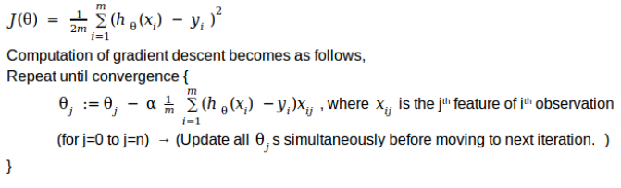
Cost Function
It is a function that measures the performance of a model for given data.
Cost Function quantifies the error between predicted values and expected values and presents it in the form of a single real number.
Taking the derivative of cost function w.r.t. x

Slide 23
Gradient Descent
One of the methods we can use to minimize cost is Gradient Descent, which is based on using gradients (derivatives) to update the model parameters (theta in our case) until a minimum is found and the gradient becomes zero.
Learning rate gives the rate of speed where the gradient moves during gradient descent.
Setting it too high would make your path instable, too low would make convergence slow.
Put it to zero means your model isn't learning anything from the gradients.

Slide 24
Dataset Description
We are going to use a dataset of startup companies to predict profit with five columns in it.
1. R&D Spend
2. Administration
3. Marketing Spend
4. State
5. Profit

Slide 25
Multivariable Linear Regression using Gradient Descent Steps
Step 1: Load dataset into dataframe using Pandas
Step 2: Load dataset into numpy arrays x and y
Step 3: Using gradient descent calculate the parameters θ₀ to θ_{n}.
Step 4: Plot the original datapoints (x,y) and (predicted values,x).
Step 5: Predict the value of Y for a test input X

